Slide 1
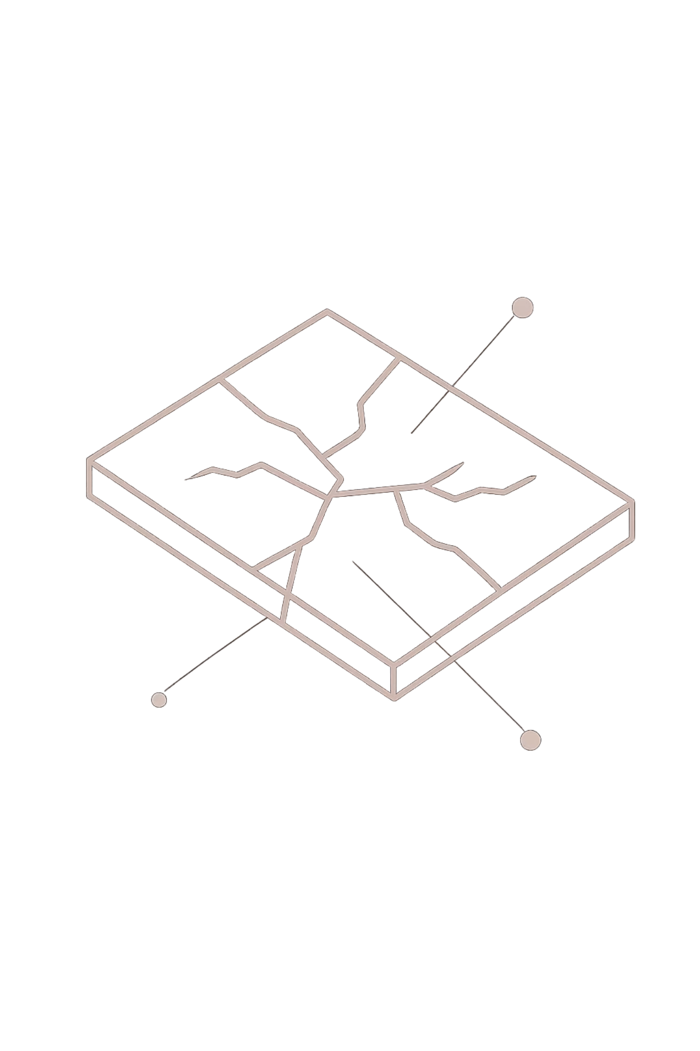

Automated Crack Detection using Deep Learning
A Comparative Study of Instance Segmentation Models:
YOLO (Segmentation) vs Mask R-CNN (ResNet-50 + FPN)
CIVIL ENGINEERING · MACHINE LEARNING

Slide 2
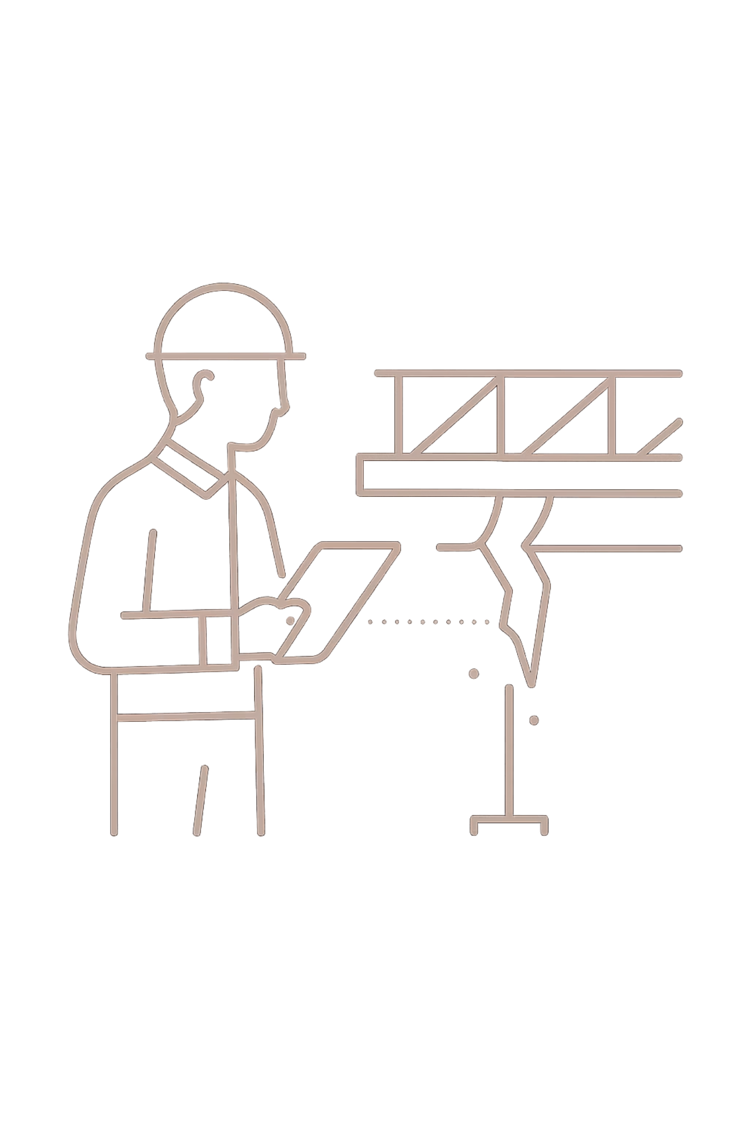

Introduction
The Problem
Our Approach
Concrete cracks are critical indicators of structural damage and safety risks. Yet traditional inspection methods are:
This project explores deep learning-based instance segmentation to automate crack detection from images.
Objective: Automatically detect and segment cracks, comparing YOLO26m-seg and Mask R-CNN + ResNet-50 to improve accuracy, efficiency, and scalability.
⏱ Time-Consuming
👁 Subjective
⚠ Error-Prone
Manual surveys slow down maintenance cycles
Results vary across inspectors
Missed cracks lead to safety failures

Slide 3


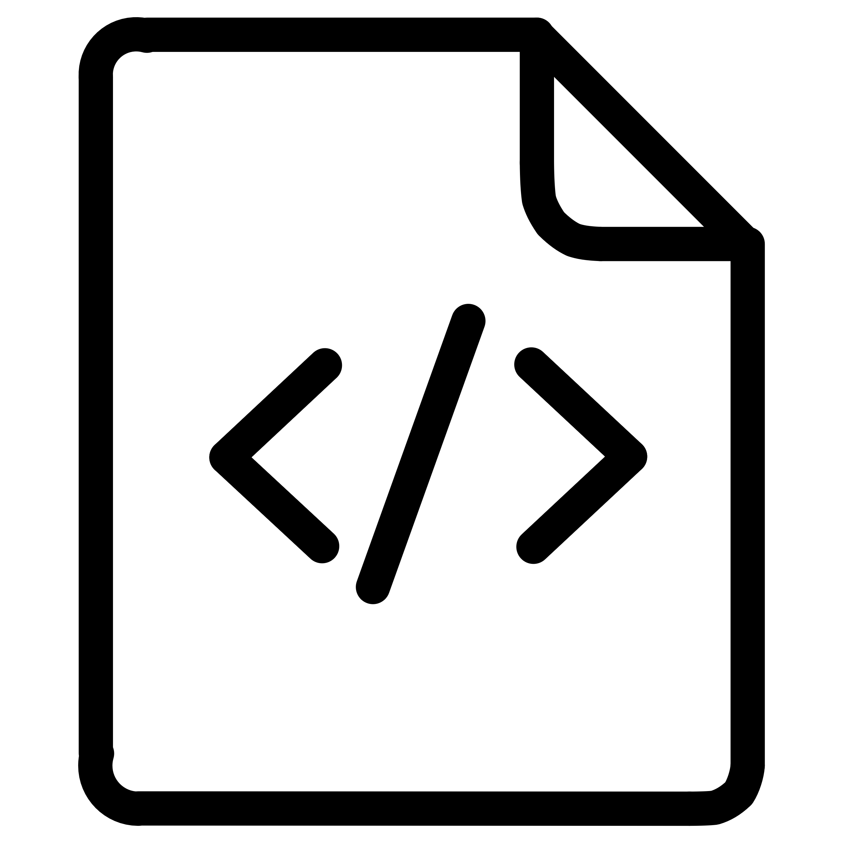
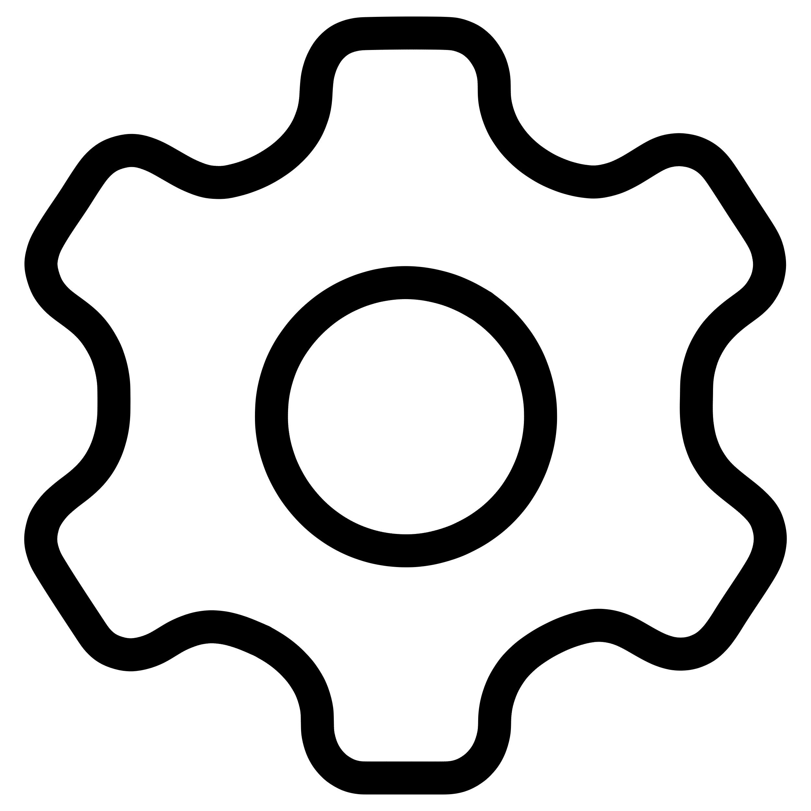

Methodology — Data Preparation
Preprocessing & Augmentation
Resolution
Restructure & Format
Images resized to 1024 × 1024; initial pairs verified at 224×224
Extract (Roboflow)
Augmentation
Verify Consistency
Horizontal flipping, blur & grayscale transforms, CLAHE contrast enhancement
Preprocess & Augment
Quality Checks
Image-mask pairing ensured; label consistency verified across YOLO segmentation format
A rigorous pipeline ensures clean, consistent data before any model training begins.

Slide 4
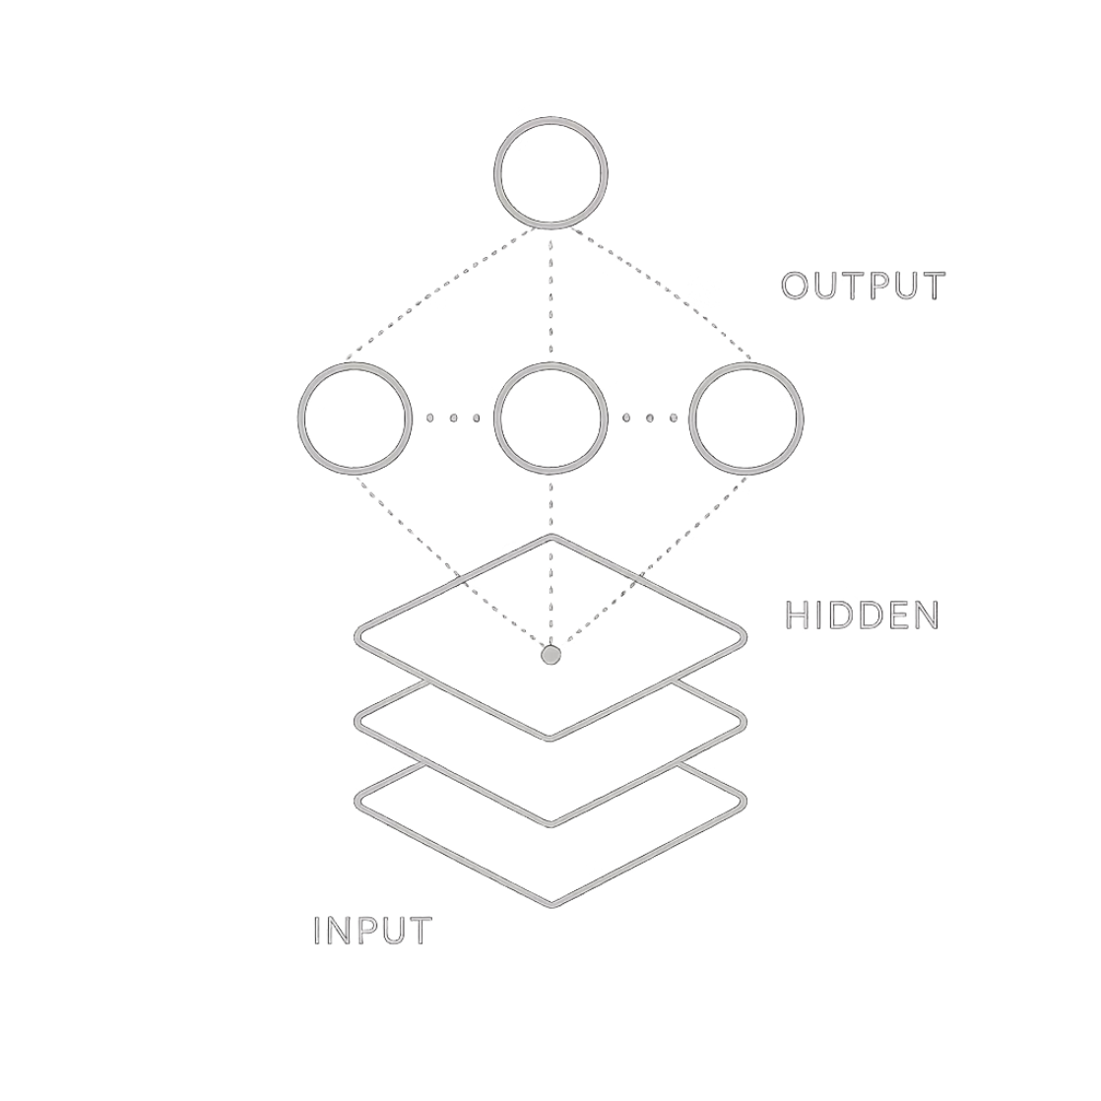
Methodology — Mask R-CNN + ResNet-50
Model Architecture
Framework
Data Preprocessing
Training
Detectron2 — Mask R-CNN backbone with ResNet-50 + FPN
Removed inconsistent annotations, corrected category IDs, filtered invalid pairs. Masks converted from polygons to binary.
Transfer learning from pretrained weights. Optimizer: Adam / AdamW. Combined classification + box + mask loss.
Fine-Tuning
Adapted to crack dataset — improved feature learning, detection accuracy, and segmentation quality.

Slide 5
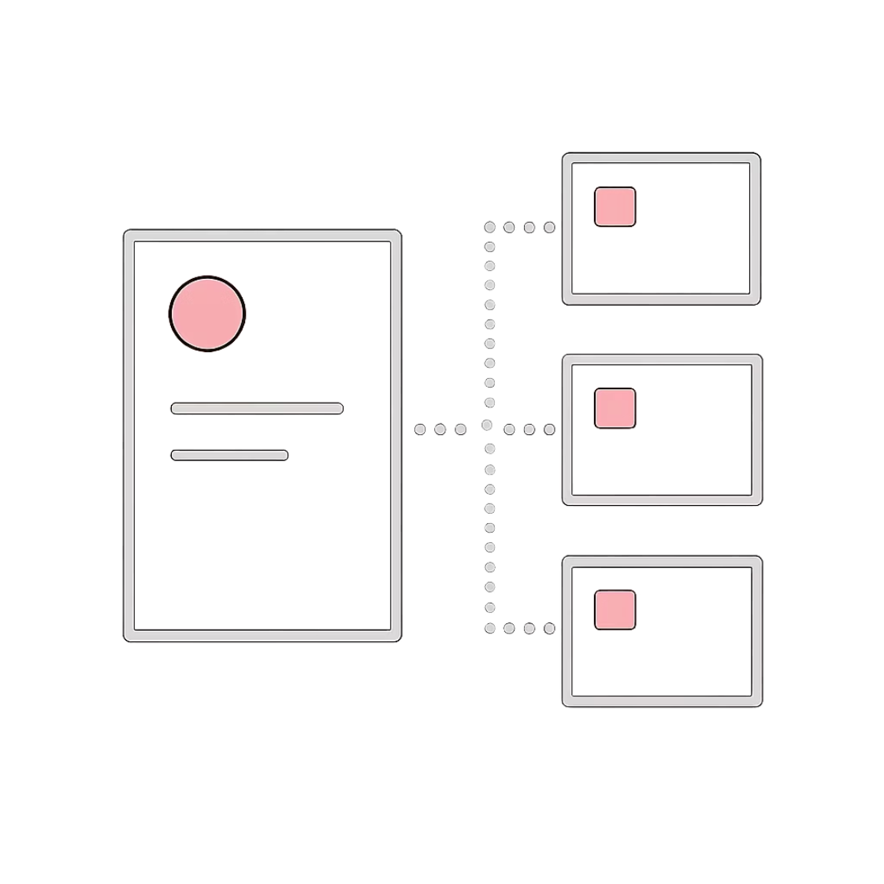




Methodology — YOLO26m-seg
Model Architecture
Backbone
Neck
Feature extraction — edges and textures at multiple scales
Multi-scale feature fusion via FPN-like architecture
Head
Predicts bounding boxes + segmentation masks simultaneously
Training: AdamW optimizer · Cosine LR scheduling + warmup · Mixed precision (AMP) · Image size 1024 · Loss = box + classification + DFL + segmentation

Slide 6
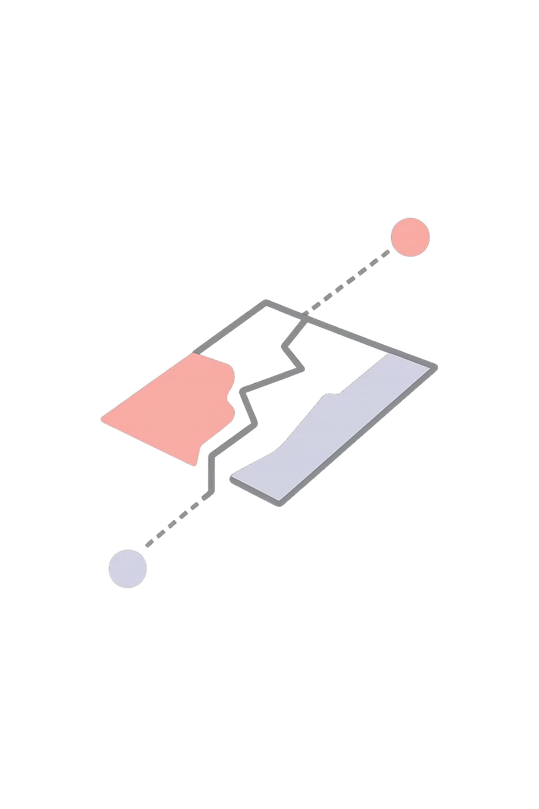

Results — Mask R-CNN + ResNet-50
0.35
0.64
BBOX mAP (0.50:0.95)
BBOX mAP@50
Strong overall crack localization
detection at lower IoU threshold
0.10-0.18
MASK Map@50
Limited segmentation precision
Detection performance is strong and consistent
• Segmentation performance is lower due to thin crack structures
• Model produces reliable bounding boxes but less precise masks

Slide 7

Results — YOLO26m-seg
Detection Performance
86%
77%
Precision
Recall
Low false positives
Detects most crack instances
85%
63%
mAP50
mAP50-95
Excellent detection accuracy
Strong across IoU thresholds
Segmentation Performance
71%
64%
Precision
Recall
Segmentation mask precision
Mask-level crack coverage
57%
21%
mAP50
mAP50-95
Moderate segmentation quality
Struggles with fine boundaries
Detection significantly outperforms segmentation — fine boundary delineation remains the key challenge.

Slide 8

Challenges
Mask R-CNN Challenges
YOLO26m-seg Challenges
Thin cracks are harder to segment accurately due to low pixel coverage
Thin and small cracks are difficult to segment due to limited spatial resolution at those scales
Annotation inconsistencies across datasets affect mask quality
Class imbalance causes the model to become biased toward background regions
Segmentation masks are less precise than bounding boxes — model struggles with irregular crack shapes
Model confuses cracks with shadows, edges, joints, and surface texture patterns

Slide 9
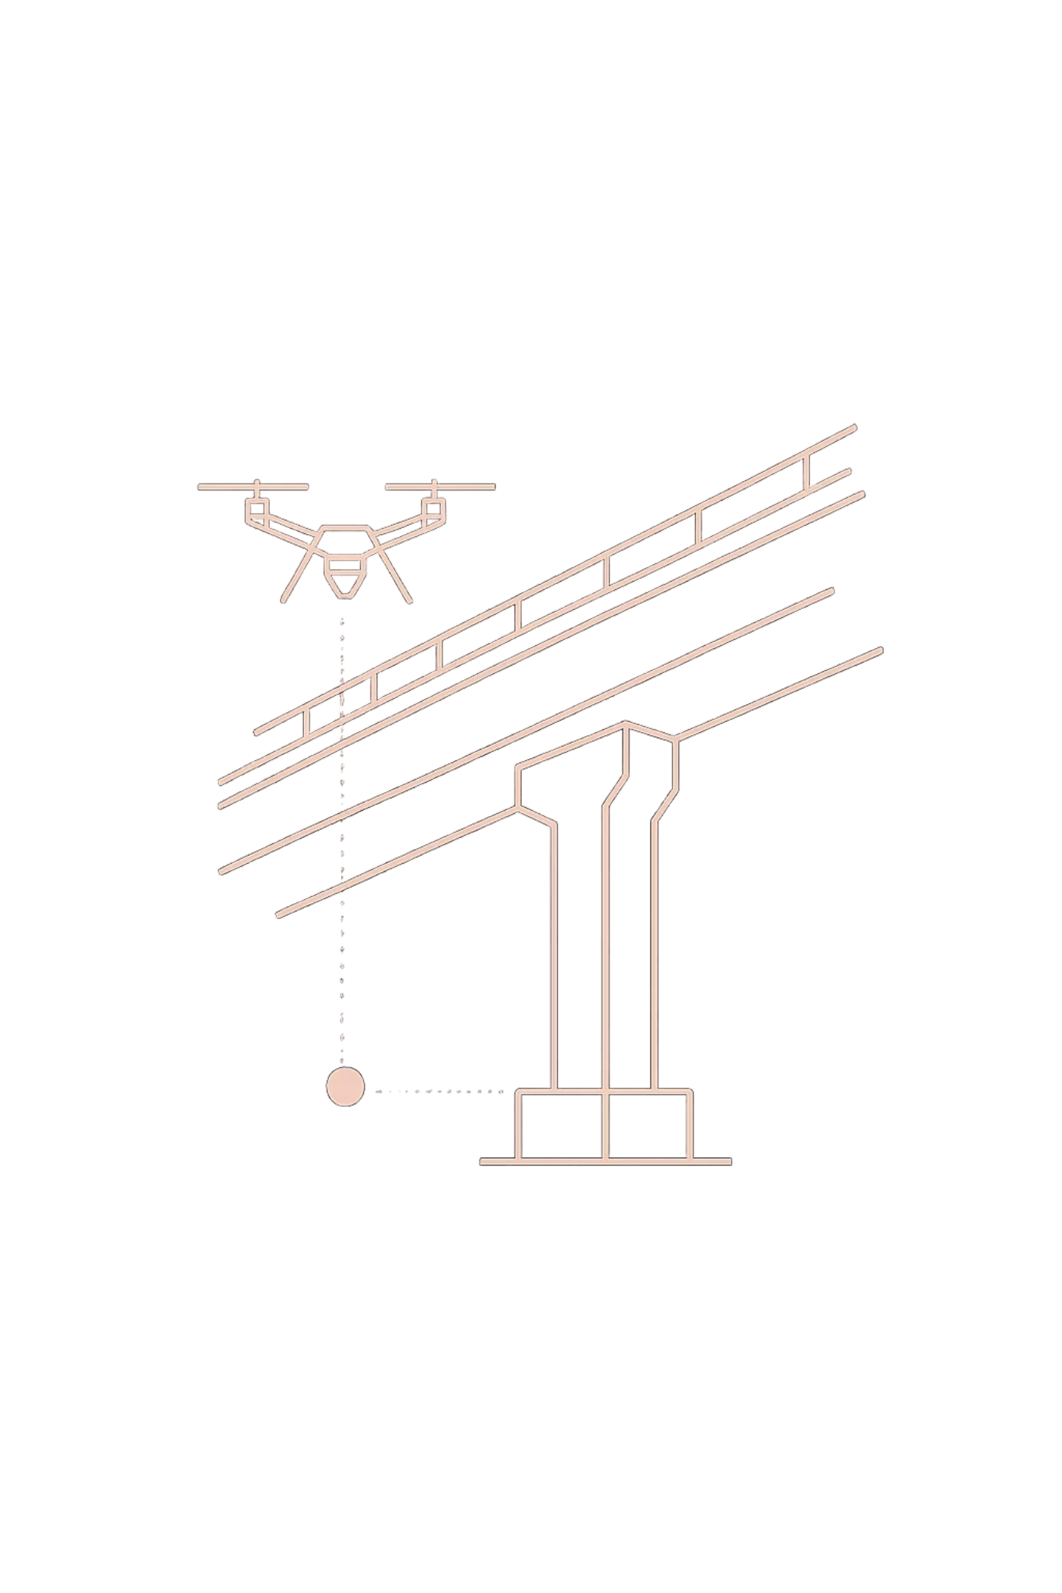



Future Enhancements
Expand the Dataset
Increase volume via synthetic crack generation (e.g., Supervisely) and real-world image collection across diverse environments
Larger & Hybrid Models
Experiment with YOLOv26l/x for higher capacity and hybrid CNN + Transformer architectures for richer feature learning
Real-World Deployment
Integrate models into mobile or drone-based inspection systems for scalable, on-site structural monitoring

Slide 10
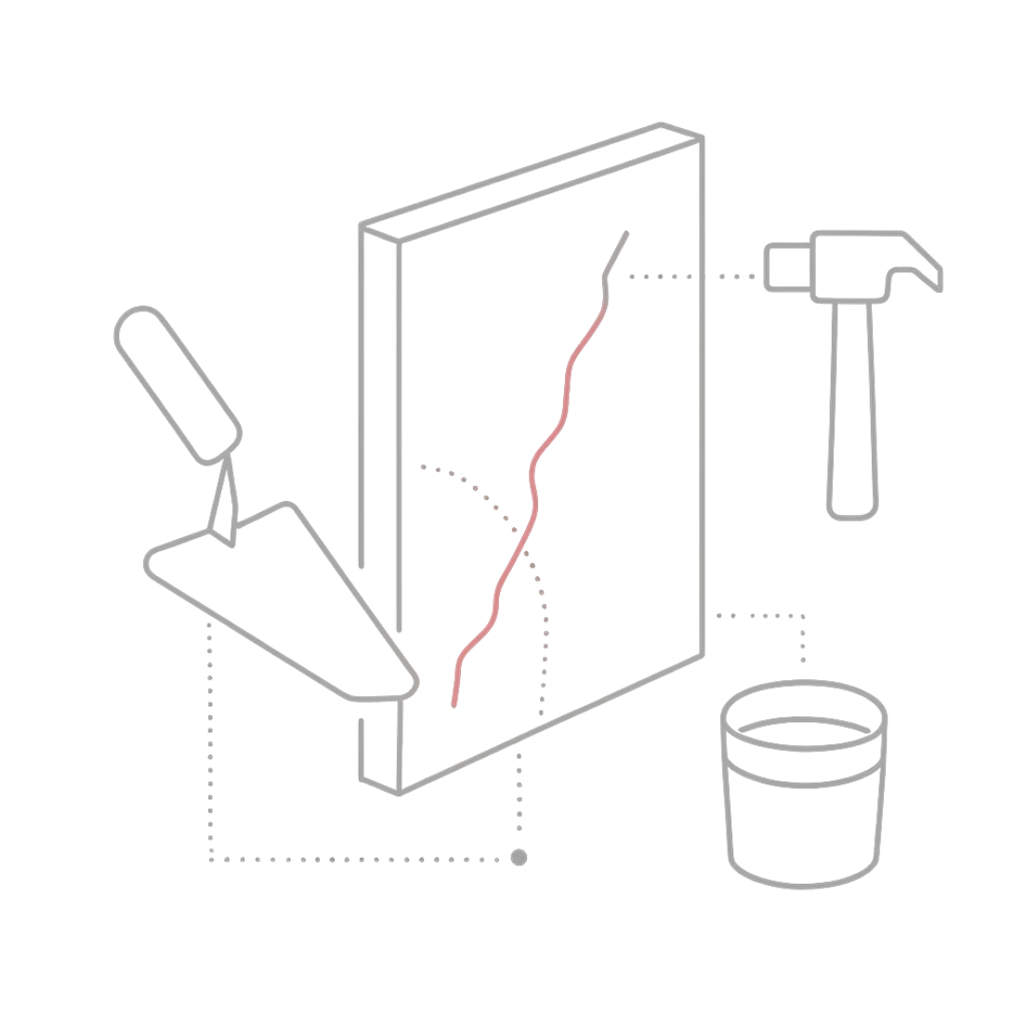
Key Takeaways
YOLO26m-seg
Mask R-CNN
Core Limitation
mAP50 0.85 — excellent detection speed and accuracy, suitable for practical deployment
mAP@50 0.64— stable training with strong localization; segmentation quality improvable
Both models struggle with thin cracks and precise boundary segmentation at tight IoU thresholds
Path Forward
Larger datasets, hybrid architectures, and real-world deployment will close the gap

